Slide 1
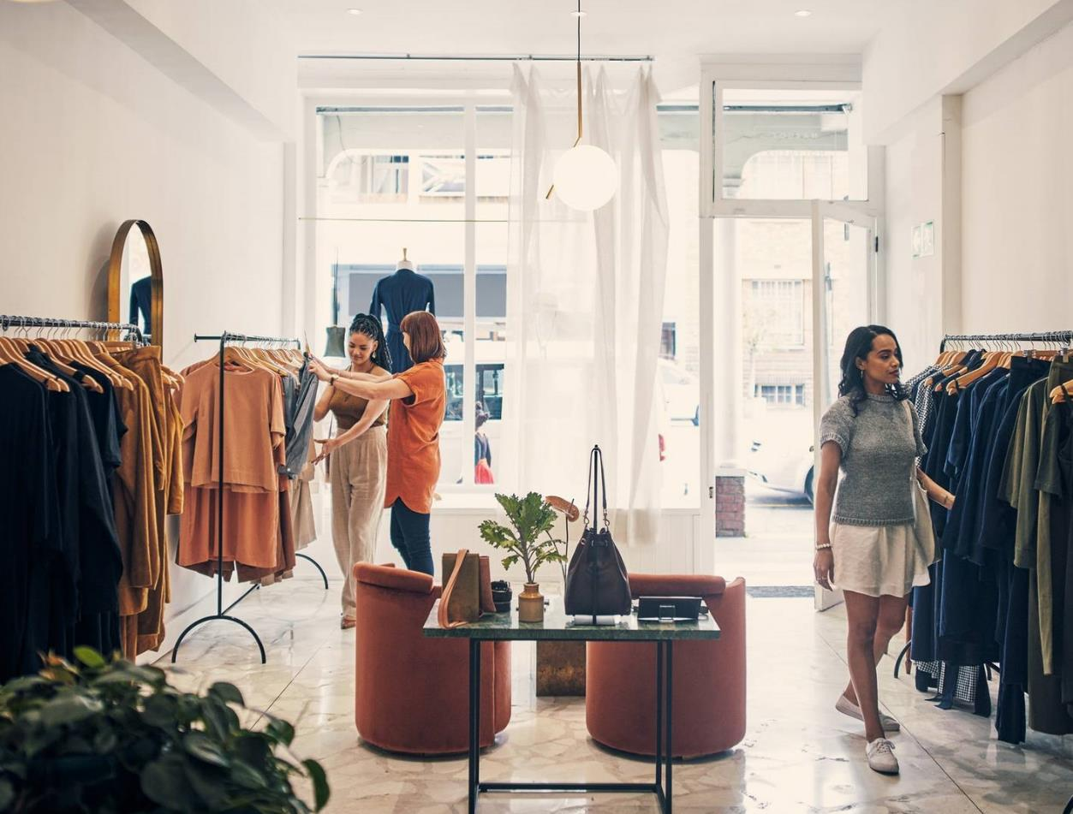
Myntra Analysis
.
-Franny Mary Joseph F

Slide 2

About Myntra
Myntra was established in February 2007 and is headquartered in Bangalore.
In 2010, the company shifted its strategy to becoming a B2C-oriented firm, expanding its catalog to fashion and lifestyle products.
Myntra.com is ranked among the top 10 e-commerce companies in India.

Slide 3
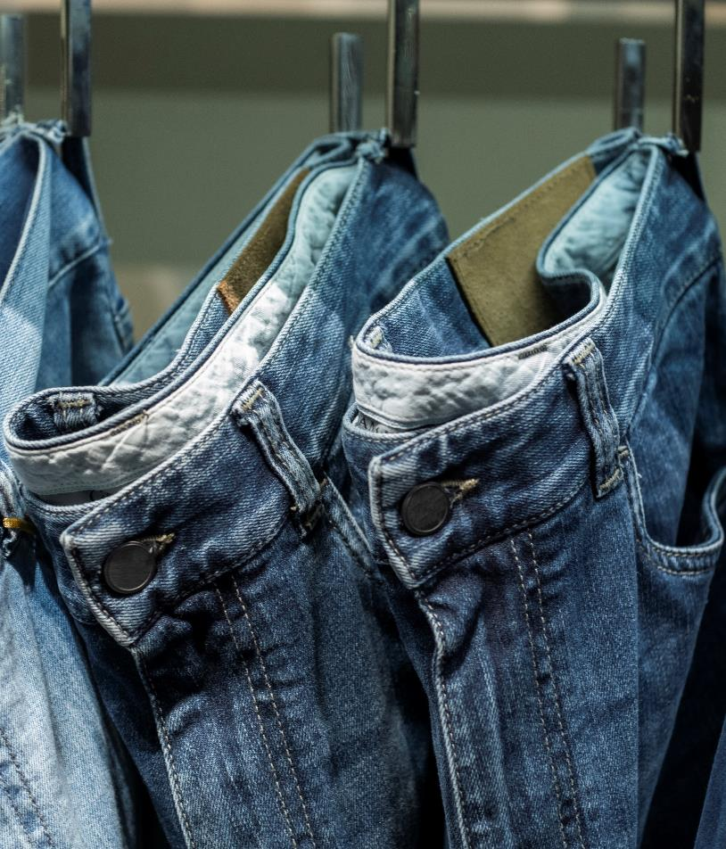
Problem
Market gap
Lack of focus on Customer Reviews so decrease in sales
Customers
69% of customers now shop online
Financials
The average customer spends an average of INR 1,804 per order
Costs
Loss of sales from not offering more customizable apps and competitor giving better deals

Slide 4




Solution
Close the gap
Target audience
Cost
Easy to use
Taking customer reviews as a benchmark and work towards better customer experience
Age Group (18-45 years old)
Having frequent offers
Make the website user friendly

Slide 5

Competitors
1.
Ajio.com
2.
Nykaa Fashion
3.
Amazon

Slide 6
Our competition
Convenient
Competitor A
Myntra
Affordable
Expensive
Competitor B
Competitor E
Competitor D
Competitor C
Inconvenient

Slide 7
BRAND PERCEPTION

Slide 8
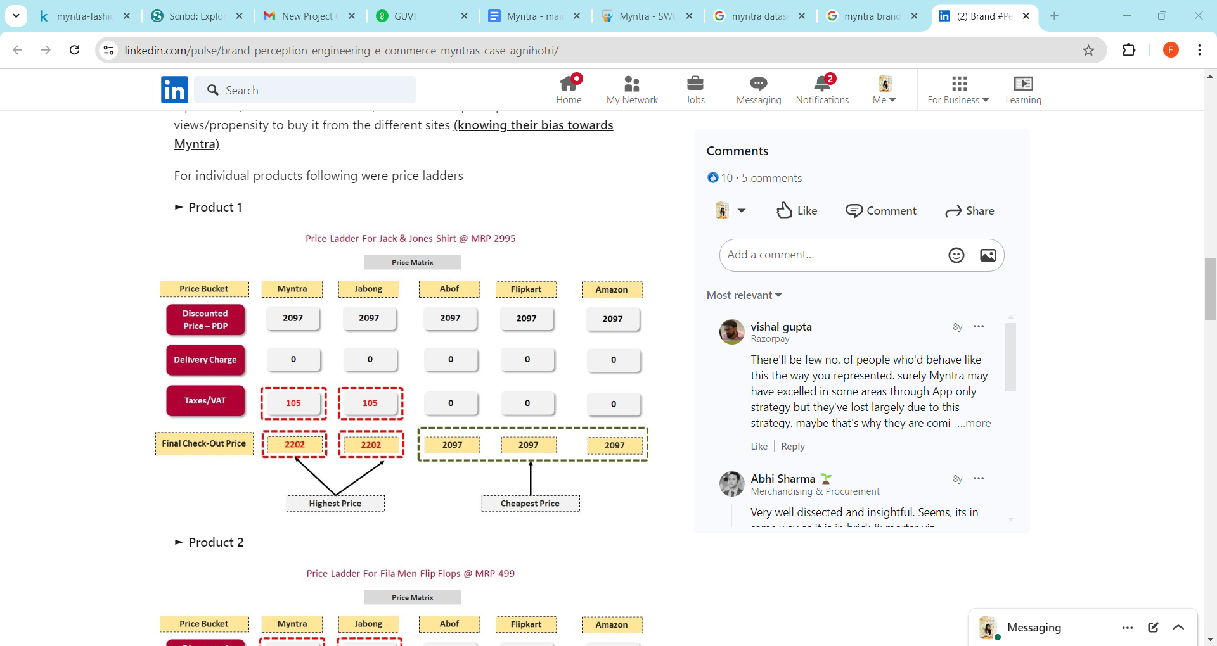
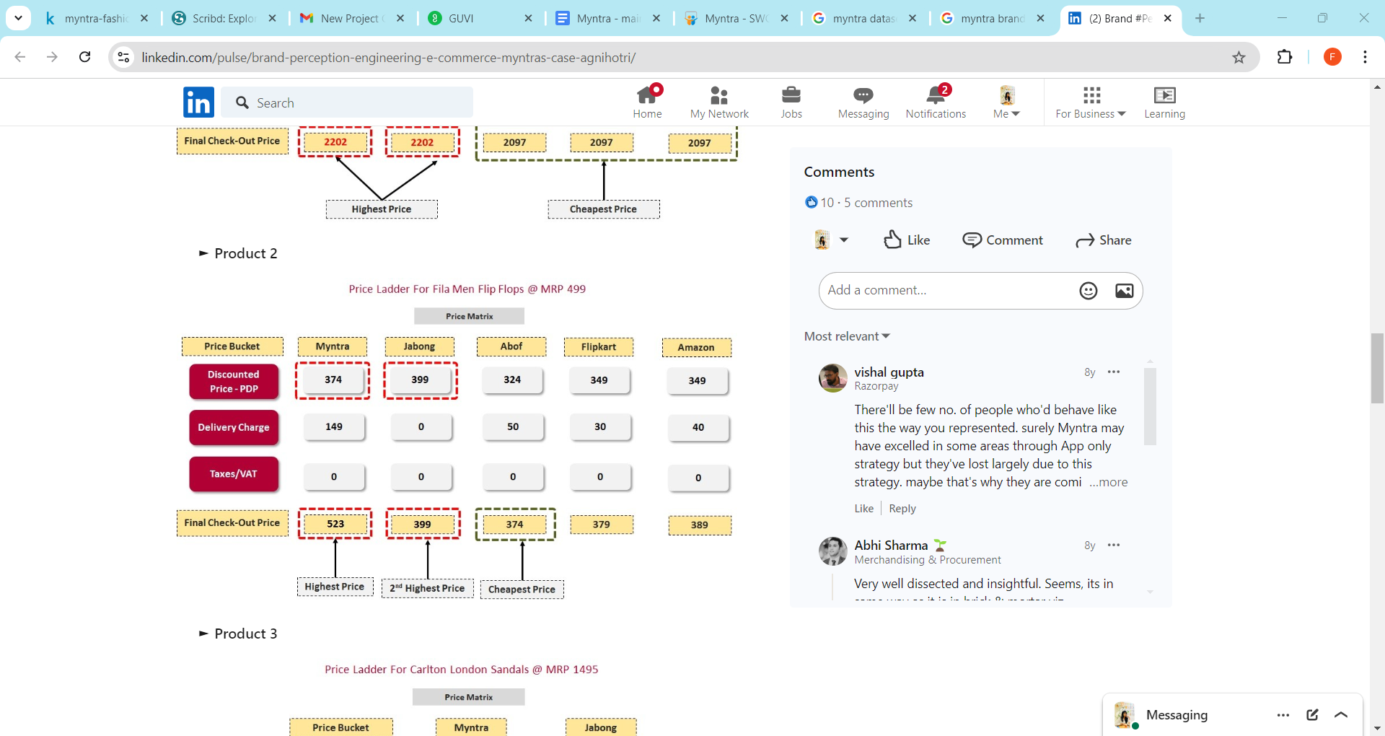
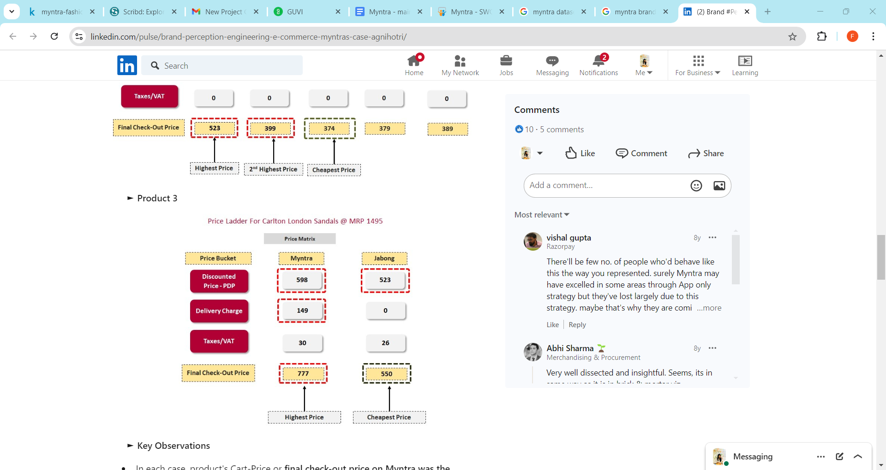
Product Specific Behaviour
Product 1: customers preferred Myntra over Jabong despite a lower price on Amazon, largely due to trust in delivery.
Product 2: While some switched to Abof for lower prices, many still favored Myntra for the delivery charge strategy.
Product 3: Despite finding lower prices on Jabong, the incentive to build a larger cart on Myntra prevailed

Slide 9
CUSTOMER SENTIMENTAL ANALYSIS

Slide 10
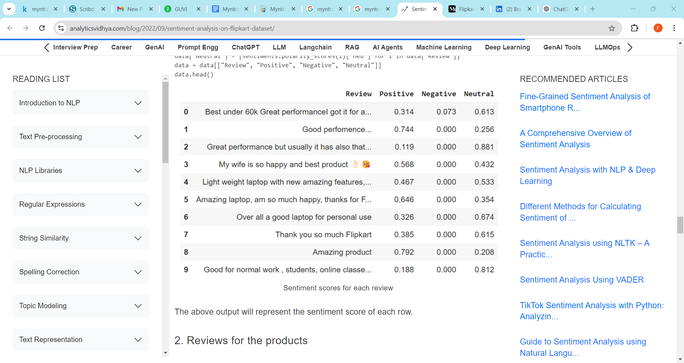
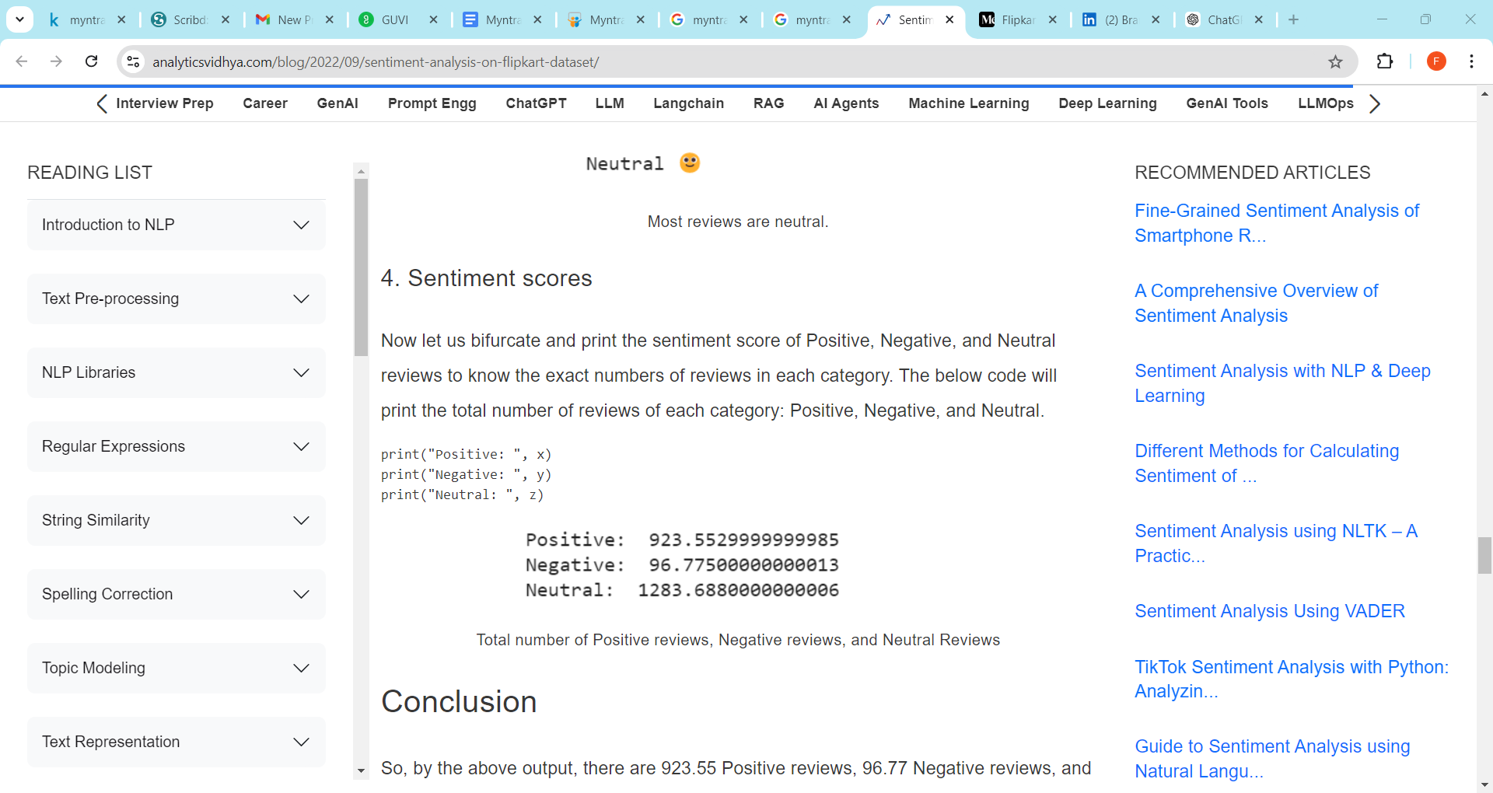
Customer Sentimental Analysis
Review Distribution:
Majority are Neutral (1283.68).
Positive reviews (923.55) show favorable customer sentiment.
Negative reviews (96.77) are minimal.
Customer Satisfaction:
Most customers are either satisfied or have a neutral stance.
Insights for Improvement:
Negative reviews help identify areas for improvement.
Sentiment analysis guides product enhancements, benefiting both customers and the company.

Slide 11
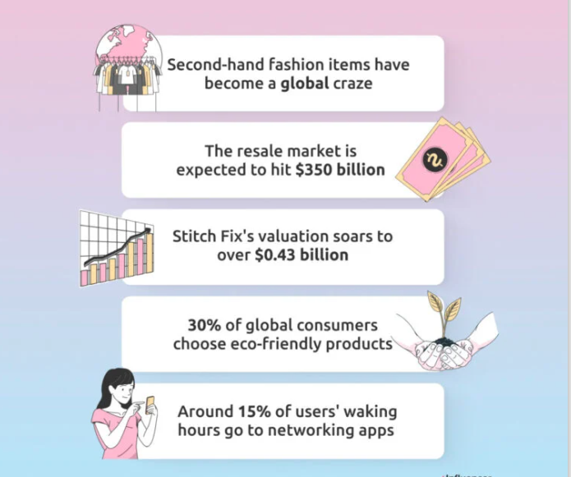
Trends in E-Commerce Industry
Most of the Consumers wake up to shopping websites. So improving the user interface in the app and website will increase sales
Consumers prefer luxury pre-loved fashion, new verticals can be used.

Slide 12
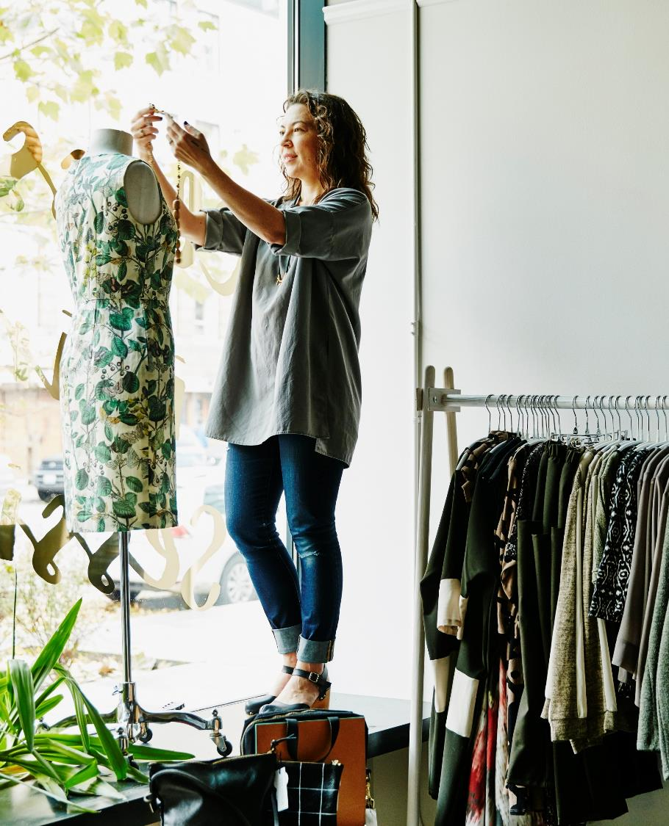
Strategic Recommendations
T
Continue App Development: Enhance the user experience on the app to maintain its position as a preferred shopping platform.
Address Delivery Charges: Consider implementing tiered delivery charges or promotions to further incentivize larger cart values without alienating price-sensitive customers.
Monitor Competitor Pricing: Regularly evaluate competitors like Flipkart and Abof to ensure that Myntra's pricing strategies remain competitive, especially on popular items.
Pre-Loved: Bringing in 2nd hand luxury good which has a huge market among the people who got influenced by influencers.

